Slide 1
Facts of the case
Analyzing the facts
Identifying cause for the success

Slide 2
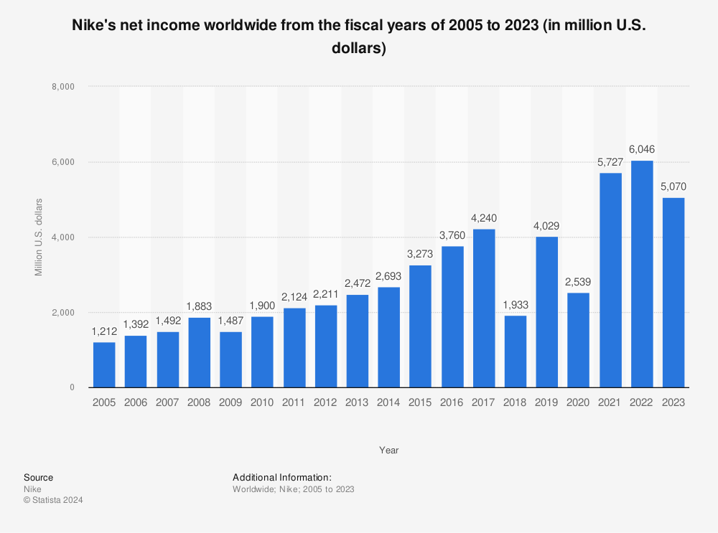
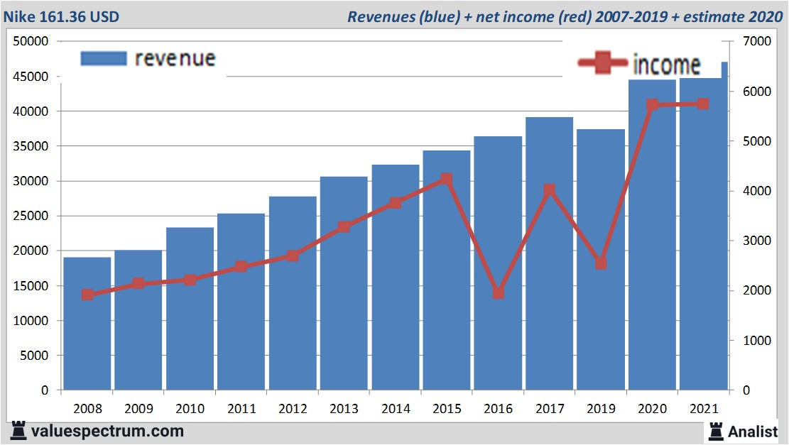
Graphical presentation of Revenue and net income

Slide 3
Identifying the cause
Strong Brand recognition and marketing
high profile athletes and events
Including sponsorship
Direct-to-Consumer Strategy
International Expansion
Focused on innovation and product development
Differentiation
Higher margin
Brand reputation

Slide 4
Reason for strong balance sheet and cash flow
Efficient working capital management
Cost management
Strong pricing and Margins

